Slide 1
CUSTOMER SATISFACTION SURVEY ANALYSIS
Subtitle: A Comprehensive Overview of Key Insights, Trends, and Recommendations
Date: [08/01/2025]

Slide 2
INTRODUCTION
Objective: Understand customer satisfaction levels and identify key pain points.
Scope: Analyze survey data, sentiment, trends, and demographics.
Outcome: Actionable recommendations for improving customer satisfaction.

Slide 3
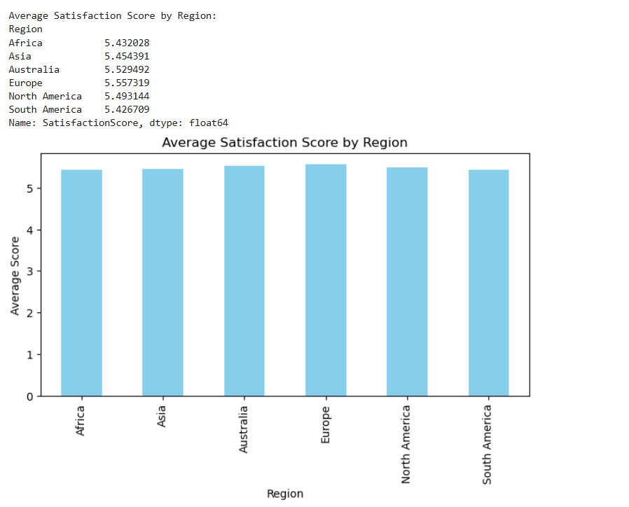
ANALYZE CUSTOMER SATISFACTION SCORES BY REGION

Slide 4
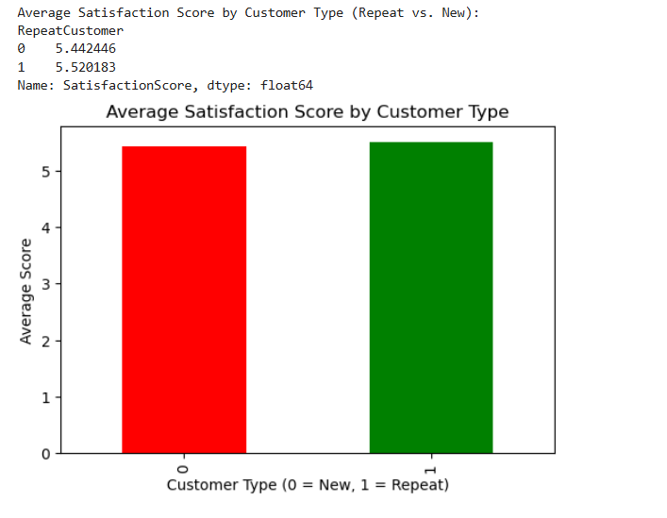
COMPARE SATISFACTION SCORES FOR REPEAT VS. NEW CUSTOMERS

Slide 5
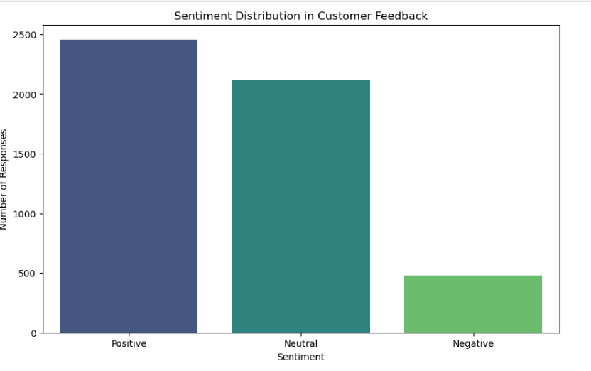
VISUALIZE SENTIMENT DISTRIBUTION

Slide 6
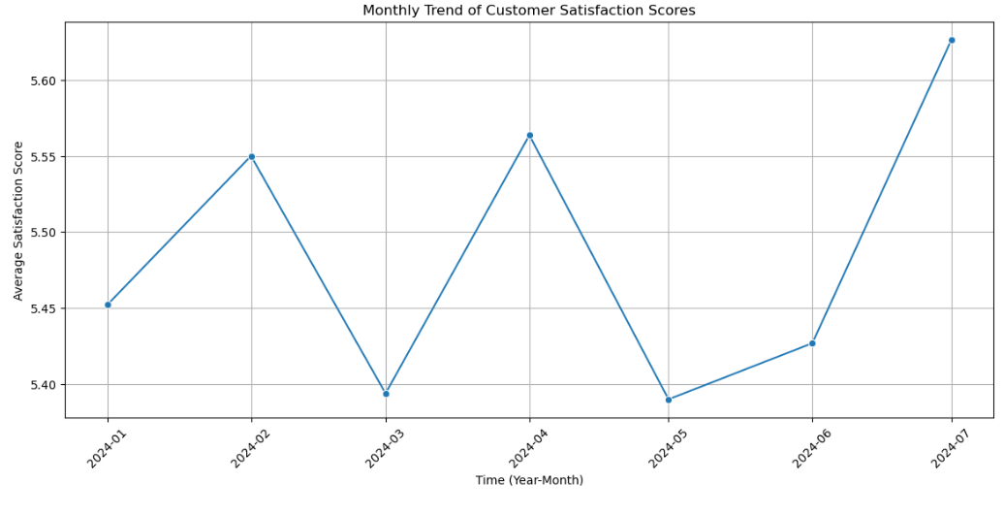
VISUALIZE SATISFACTION TRENDS OVER TIME
* Line Plot for Satisfaction Trends

Slide 7
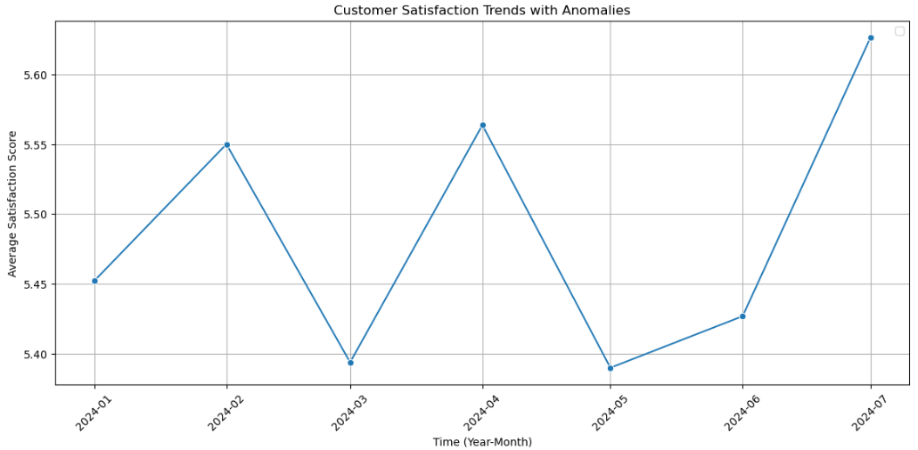
IDENTIFY ANOMALIES IN SATISFACTION SCORES

Slide 8
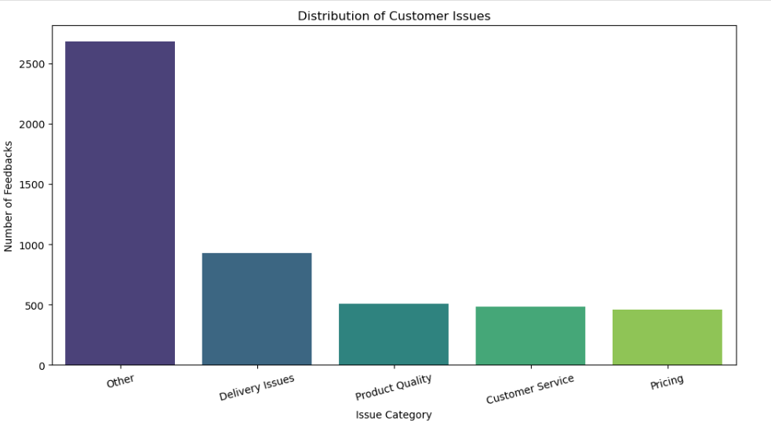
VISUALIZE ISSUE CATEGORIES

Slide 9
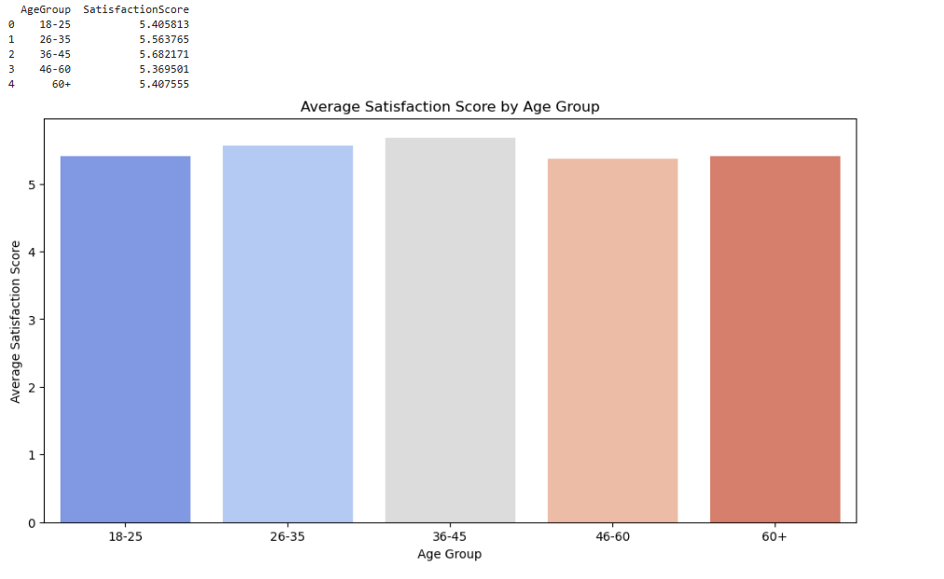
ANALYZE SATISFACTION BY AGE GROUP

Slide 10
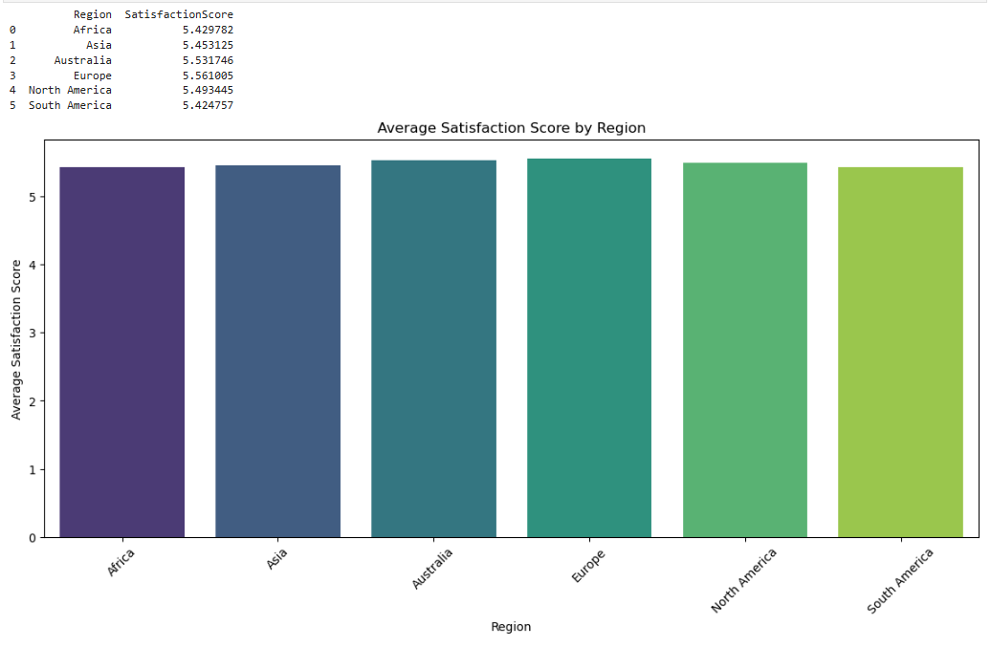
SEGMENT BY REGION
Analyze Satisfaction by Region

Slide 11
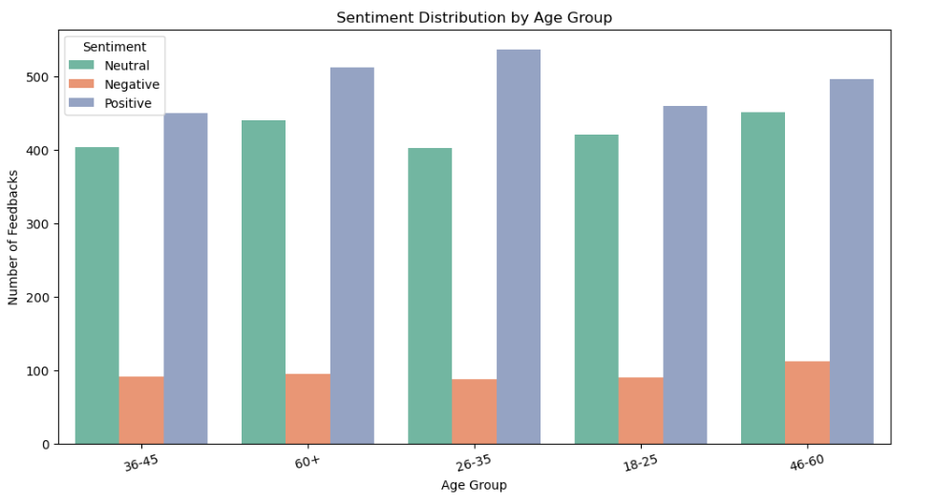
SENTIMENT DISTRIBUTION ACROSS DEMOGRAPHICS
Sentiment by Age Group

Slide 12
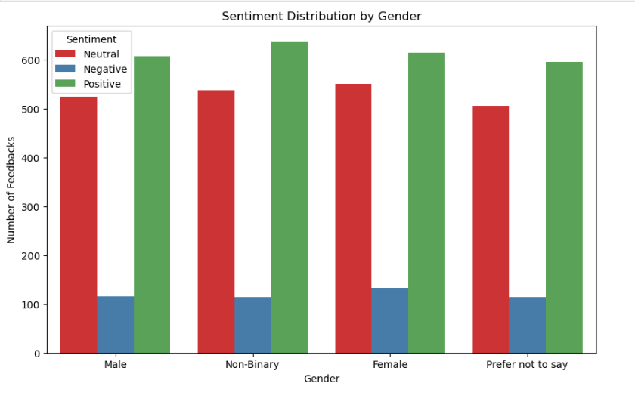
SENTIMENT BY GENDER

Slide 13
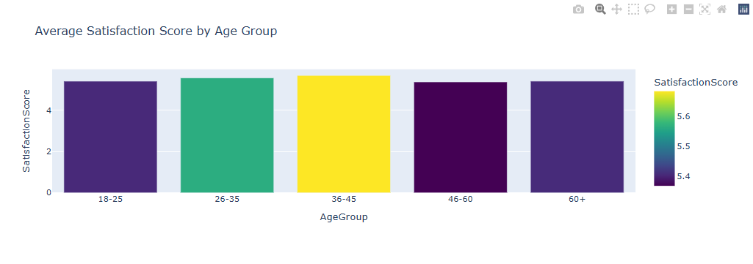
DEMOGRAPHIC ANALYSIS
Satisfaction by Age Group

Slide 14
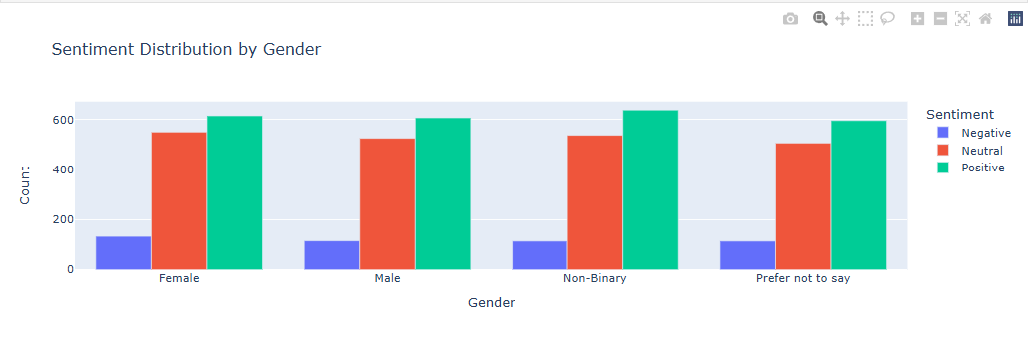

Slide 15
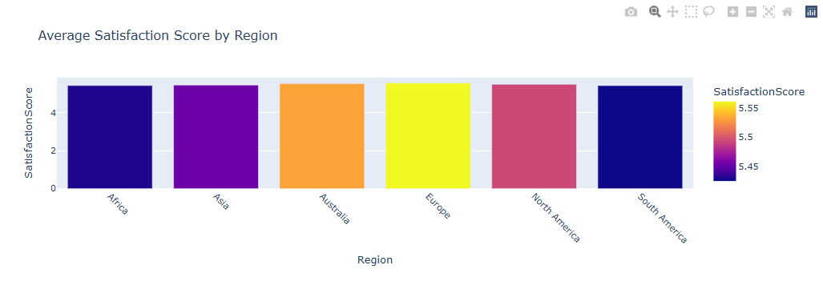

Slide 16
RECOMMENDATIONS
1).Improve Delivery Timelines:
Implement advanced logistics tracking systems.
Partner with reliable delivery service providers.
Optimize warehouse management for faster dispatch.
2)Enhance Product Quality:
Introduce stricter quality control processes.
Regular audits on high-return products.
Collaborate with suppliers for quality assurance.
3)Strengthen Customer Support Services:
Invest in staff training for better query resolution.
Increase availability of live support agents during peak hours.
Implement automated chat support for common inquiries.

Slide 17
4) Focus on Customer Feedback Integration:
Regularly monitor and address recurring complaints.
Use AI tools for real-time sentiment analysis.
Create a feedback acknowledgment and follow-up system.
5) Target Demographic-Specific Improvements:
Address age group-specific satisfaction issues.
Offer tailored promotions and experiences for different customer groups.
Study regional trends and address location-based concerns.
6) Encourage Customer Engagement:
Reward customers for survey participation.
Host webinars or Q&A sessions for customer concerns.
Create community forums for product discussions.

Slide 18
CONCLUSION
The survey analysis revealed key insights into customer satisfaction trends, recurring complaints, and demographic preferences.
Major concerns included delivery delays, product quality issues, and inconsistent customer service experiences.
Despite these issues, positive sentiment dominated overall feedback, indicating strong brand loyalty among satisfied customers.
Addressing the highlighted areas of concern will lead to improved customer satisfaction, enhanced loyalty, and better overall business performance.
Continuous monitoring, effective communication, and prompt implementation of recommendations are essential for long-term success.

Slide 19
THANK
YOU

